Slide 1
PYTHON GUI TECHNOLOGY
SEMINAR
BY : NAGMANI KUMAR
ROLL NO: 1722510106
Collage : Accurate Institute of Management
and Technology

Slide 2
IMPORTANCE OF PYTHON TECHNOLOGY
Machine Learning and Artificial Intelligence
2. Web Development
Game Development
Data Science and Data Visualization
Desktop GUI
Embedded Applications
Audio and Video Applications

Slide 3
Technology used in our GuI application
1 . Python basic language
DB Browser for SQLITE
this data base use for standard alone application
Tools : python IDLE used ,or PYCHARM GUI

Slide 4
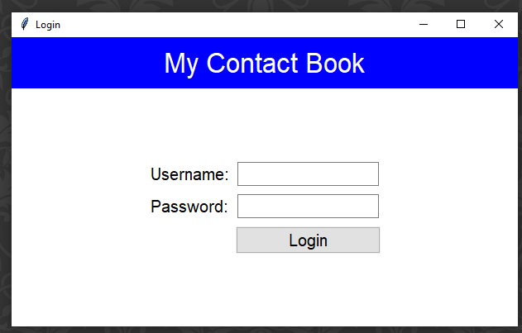
LOGIN PAGE
admin
*****
click

Slide 5
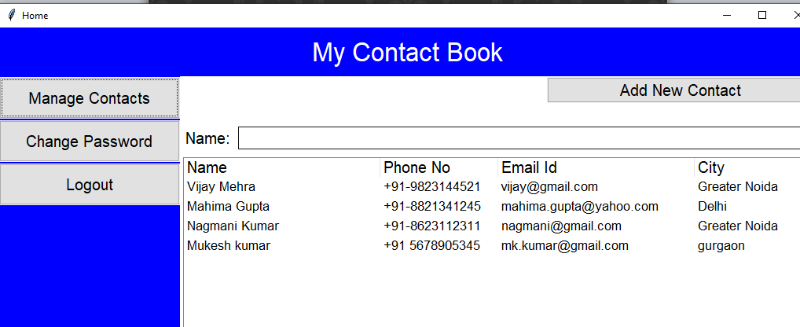
Click Manage Contacts

Slide 6
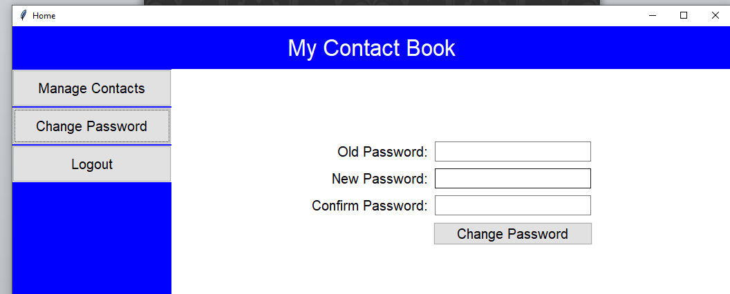
Click change password
Conform change password

Slide 7
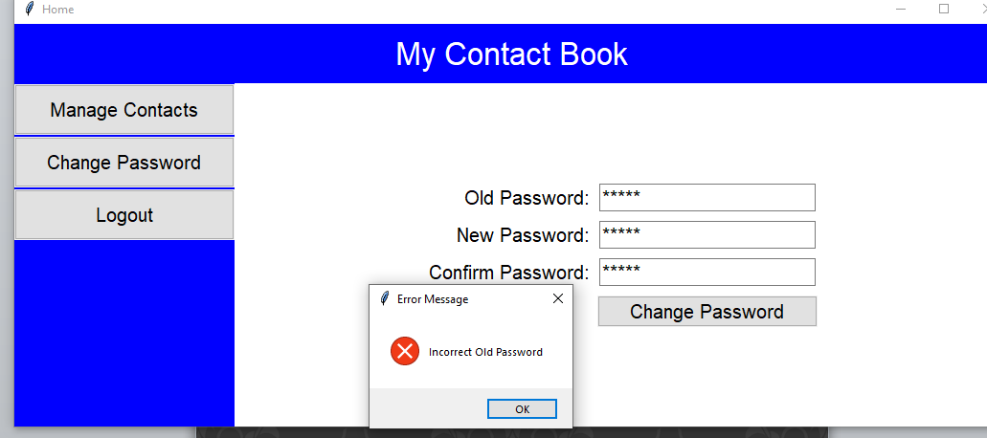
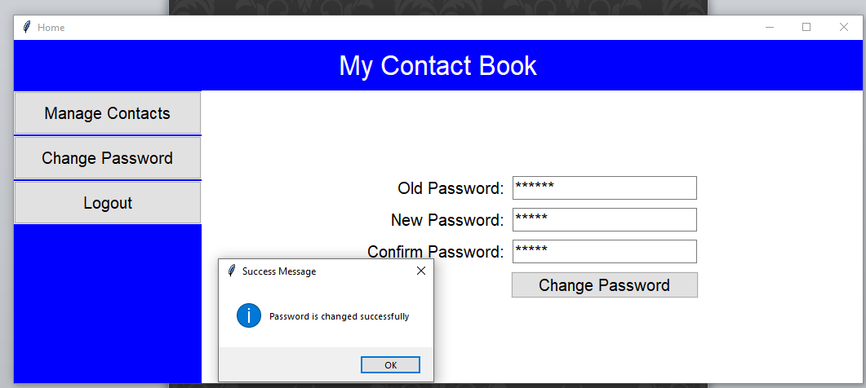
Click conform Change password

Slide 8
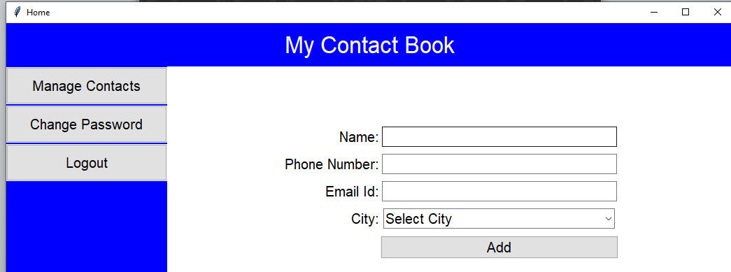
Add new contact click

Slide 9
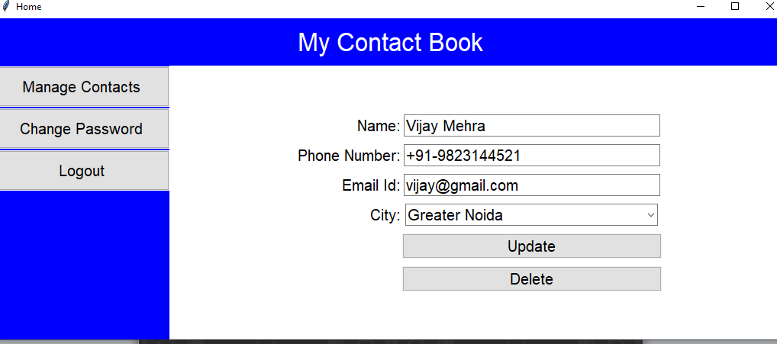
Select any row in table
Modify the selected data in row

Slide 11
Future Scope Of Python Programming
Python is a high level and multi-paradigm programming language designed by Guido van Rossum a Dutch programmer
1. having all the features as conventional programming languages such as C, C++ and Java have.
It is one of the fastest growing languages and has undergone a successful span of more than 25 years as far as its adoption is concerned. This success also reveals a promising future scope of python programming language.
2. In fact, it has been continuously serving as the best programming language for application development, web development, game development, system administration, scientific and numeric computing, GIS and Mapping etc.

Slide 12
Why Is Python So Popular?
The reason behind the immense popularity of python programming language across the globe is the features it provides.
FEATURES OF PYTHON LANGUAGE
(1) Python Supports Multiple Programming Paradigms.
(2) Python Has Large Set Of Library and Tools.
(3) Python Has a Vast Community Support.
(4) Python is Designed For Better Code Readability. (5) Python Contains Fewer Lines Of Codes.
THANK YOU !!!

